Slide 1


CS-429 Introduction to Data Science
Page-Rank Algorithm
Mubashir Iqbal
Lecturer in Computer Science Department
HITEC University Taxila

Slide 2


Page Rank
PageRank is a link analysis algorithm developed by Larry Page and Sergey Brin, the founders of Google, to rank web pages in search engine results.
It measures the importance of a webpage based on the quantity and quality of links pointing to it.
Larry Page
Sergey Brin

Slide 3
How it Works?
Web pages are treated as nodes, hyperlinks between pages are considered directed edges in a graph.
A webpage is important if many important pages link to it. The value of a linking page adds to the importance of the page it links to.
The algorithm imagines a “random surfer” who clicks on links randomly and sometimes goes to a random page.

Slide 4
Formula
d: Damping factor (usually 0.85).
N: Total number of pages or nodes in the graph.
Li​ : Pages linking to 𝑃age_A.
PR(Li​): PageRank of 𝐿𝑖
C(Li​): Number of links on 𝐿𝑖.

Slide 5
Graphs and Their Concepts for PageRank Algorithm

Slide 6
Graphs
A graph is a mathematical structure used to model pairwise relationships between objects.
It consists of:
Nodes (Vertices): Represent entities (e.g., web pages in PageRank).
Edges: Represent connections or relationships between nodes (e.g., hyperlinks between web pages).

Slide 7
Paths and Cycle
Path: A sequence of nodes connected by edges.
Example: A -> G is a path
Cycle: A path where the start and end nodes are the same.

Slide 8
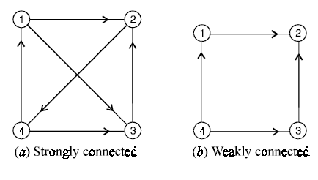
Connectivity
Strongly Connected Graph: Every node is reachable from every other node.
Weakly Connected Graph: Nodes are connected, but directions of edges may not allow traversal.

Slide 9
Types of Graphs

Slide 10
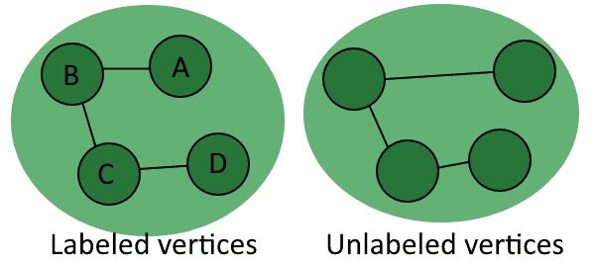
Unlabeled and Labeled Graphs
Unlabeled Graphs:
A graph where nodes and edges are not assigned any labels; only the structure (connections) matters.
Labeled Graphs:
A graph where nodes (vertices) and/or edges are assigned specific labels (names, numbers, or symbols) to provide additional information.

Slide 11
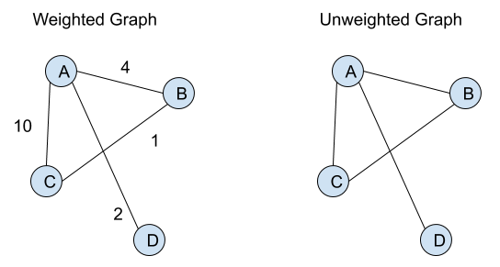
Weighted vs. Unweighted Graphs
Weighted Graph:
Edges have weights (numerical values) indicating their strength or importance.
A web page’s link may have a weight based on the frequency of clicks.
Unweighted Graph:
All edges have equal importance.
Friendship connections.

Slide 12
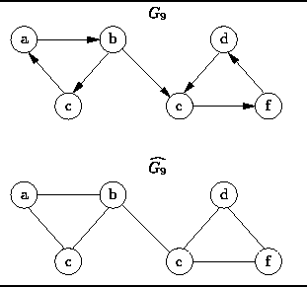
Directed and Undirected Graph
Directed Graph (Digraph):
Edges have a specific direction (arrows).
The web, where a hyperlink points from one page to another.
Undirected Graph:
Edges have no direction.
A social network where a connection is mutual.

Slide 13
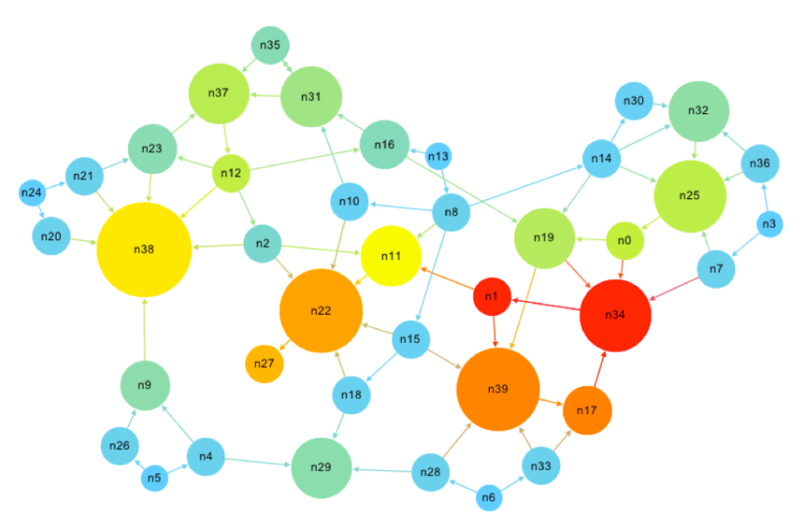
Importance of Degree in Graphs
The degree of a node is the number of edges connected to it.
In-Degree: This is the number of connections coming into a node. For example, if a webpage is linked by three other pages, its in-degree is 3.
Out-Degree: This is the number of connections going out from a node. For example, if a webpage has links to five other pages, its out-degree is 5
Degrees help us understand how
connected a node is. In PageRank,
in-degree is key because more incoming
links usually mean higher importance

Slide 14
Building the Transition to PageRank
Ranking in graphs is about finding which nodes (e.g., webpages) are the most important or influential. For example, in a network of web pages, some pages are more popular because many other pages link to them.
PageRank uses this idea to rank web pages. It works like this
A page gets a high rank if many pages link to it (in degree).
A page also gets a high rank if it is linked by other important pages.

Slide 15
PageRank
Imagine a library where books are arranged based on how often they are recommended by other popular books.
Similarly, PageRank calculates the importance of web pages using the graph of links between them.

Slide 16
The Damping Factor (d)
The algorithm assumes that the random surfer doesn’t always follow links.
Sometimes, the surfer/visitor jumps to a random page (teleportation).
The damping factor (usually set to 0.85) accounts for this behavior:
85% of the time, the surfer follows a link.
15% of the time, they jump to a random page.
This prevents dead ends and ensures every page gets a rank.

Slide 17
Handling Dead Ends and Dangling Nodes
Dead Ends: Pages with no outgoing links.
These pages can disrupt the computation as they "trap" the surfer.
Solution: Add random links or redistribute rank equally to all pages.
Dangling Nodes: Nodes with zero out-degree.
Similar to dead ends but are treated slightly differently in practice.

Slide 18
Example of calculating PR
compute page ranks of all nodes.
A
B
d: Damping factor (usually 0.85).
N: Total number of pages = 4.
Li​ : Pages linking to 𝑃age_A.
PR(Li​): PageRank of 𝐿𝑖
C(Li​): Number of links on 𝐿𝑖.
C
D

Slide 19
Example of calculating PR
First iteration
As there are N = 4 pages in total, so initial Page Rank of all pages are 1/N
A
B
 | Iteration 1
P (A) | 0.25
P (B) | 0.25
P (C) | 0.25
P (D) | 0.25
SUM | 1
C
D

Slide 20
Example of calculating PR
2nd iteration
A
B
C
 | Iteration 1 | Iteration 2
P (A) | 0.25 | 0.1083
P (B) | 0.25 | 0.2145
P (C) | 0.25 | 0.3562
P (D) | 0.25 | 0.3205
SUM | 1 | 1
D

Slide 21
Example of calculating PR
3rd iteration
A
B
C
 | Iteration 1 | Iteration 2 | Iteration 3
P (A) | 0.25 | 0.1083 | 0.1384
P (B) | 0.25 | 0.2145 | 0.1844
P (C) | 0.25 | 0.3562 | 0.3562
P (D) | 0.25 | 0.3205 | 0.3207
SUM | 1 | 1 | 1
D

Slide 22
Example of calculating PR
How much iteration is needed?
It continues until the changes between the PageRank values in consecutive iterations are below a threshold (e.g., ).
The number of iterations required depends on:
Graph Size: Larger graphs typically require more iterations.
Damping Factor (d): A common value is 0.85, but smaller values can converge faster.
Graph Structure: Highly connected graphs or those with loops may require more iterations.
In some cases, the number of iterations is fixed (e.g., 100 iterations) instead of checking for convergence, especially for large graphs.

Slide 23
Applications of PageRank Algorithm

Slide 24
Applications of PageRank Algorithm
1. Search Engine Ranking:
PageRank was originally the backbone of Google’s search engine. It helps in ranking search results based on the relevance and authority of web pages.
2. Social Network Analysis:
Used to determine the influence of individuals or nodes within a social network. E.g., finding influential users on Twitter or LinkedIn.

Slide 25
Applications of PageRank Algorithm
3. Recommendation Systems:
Applied in ranking items or products in recommendation engines.
4. Scientific Research:
Helps rank research papers based on citations, similar to how webpages are ranked based on hyperlinks.
5. Web Crawling and Indexing:
Guides web crawlers to prioritize high-ranking pages during indexing.

Slide 26
Applications of PageRank Algorithm
6. E-commerce Platforms:
Used to rank sellers or products by importance or relevance.
7. Fraud Detection:
Detects link farms and manipulative behaviors in web structures by identifying artificially inflated PageRank values.
8. Biological Networks:
Applied to identify important proteins or genes in biological interaction networks.
9. Traffic Flow Analysis:
Determines important nodes in transportation and traffic networks.

Slide 27
Challenges and Limitations
Manipulation and Spam Links:
The algorithm’s reliance on link structure makes it susceptible to manipulation.
Websites or groups can create link farms (a network of interconnected pages) to artificially boost their ranks. This undermines the algorithm’s goal of identifying genuinely valuable or relevant pages.
To address this, additional filters or penalties for suspicious link patterns are often required.

Slide 28
Challenges and Limitations
Dynamic Nature of the Web:
The internet is continuously evolving, with new pages being created, updated, or removed.
As a result, the PageRank calculation, which is computationally intensive, needs to be recalculated frequently to stay accurate.
This poses a significant scalability challenge, especially given the billions of pages on the web.

Slide 29
Challenges and Limitations
Dead Ends and Dangling Nodes:
Pages with no outgoing links (dead ends) and nodes with zero out-degree (dangling nodes) can disrupt the flow of PageRank scores, potentially leading to incorrect results.
Although the damping factor helps mitigate this, handling such nodes effectively remains a challenge in large and complex graphs.

Slide 30
Challenges and Limitations
Bias Toward Older or Popular Pages:
PageRank tends to favor pages with more incoming links, which often belong to older or already popular websites.
New or lesser-known pages, even if highly relevant, might struggle to achieve a high rank, leading to a lack of diversity in search results.

Slide 31
Challenges and Limitations
Computational Complexity:
Calculating PageRank for a large graph with millions or billions of nodes requires significant computational resources.
The iterative nature of the algorithm further increases the cost, as multiple iterations are needed until convergence.
This can make it difficult to apply in real-time scenarios.

Slide 32
Challenges and Limitations
Ignoring Content Quality:
PageRank focuses solely on the link structure of a graph and doesn’t account for the actual content quality of the pages.
A page may have many incoming links but still provide low-quality or irrelevant content.
Modern search engines often combine PageRank with other content-based algorithms to address this limitation.

Slide 33
Challenges and Limitations
Limited Adaptability:
PageRank assumes the uniform behavior of the random surfer/visitor, but real users often have specific goals or interests.
The standard algorithm doesn’t adapt to user preferences, making it less effective for personalized applications.
Extensions like Personalized PageRank aim to solve this issue.

Slide 34


Slide 35

Not included in the Syllabus
Urdu Book: Jab Zindagi Shoro hogi, By by Abu Yahya
URL:
Pages: 00:28:51

